Slide 1
EDA Case Study
By
Abhimanyu Dasarwar
Abhishek Kumar

Slide 2
Approaching the Case Study :
For a firm, we need to analyze the factors those lead for a individual to default.
Target = 0 says that individual has not defaulted
Target = 1 say that individual has defaulted.
Using the data provided, we have found out which are the factors those lead to default for a individual.
After loading the data into python, we have performed the analysis which can be used to decide if a individual will default or not.

Slide 3
Finding the missing values :
Missing values were found out from a column
If the column contained more than 50% NA values, those columns were dropped from the database to reduce the database size and to get useful insights from remaining columns
Out of 122 Columns, 41 Columns had more than 50 % NA Values. These columns were dropped from the database.
Remaining 81 Columns had less than 50 % NA Values.
Those missing values were treated using MEAN, MODE, MEDIAN functions.
For Categorical columns, NA values can be replaced with MODE values of that column.
For Continuous Value Columns, NA values can be replaced with MEAN or MEDIAN depending on the outliers present in the column.
If the data contains outliers, values were replaced using MEDIAN
If the data does not contain outliers then values were replaced using MEAN

Slide 4
Checking for Data Type Mismatch
There were some columns whose data types did not match.
We have changed the data type for such columns.
For Example : TARGET was a categorical column but had INT data type.
Changed it to Categorical Data Type.

Slide 5
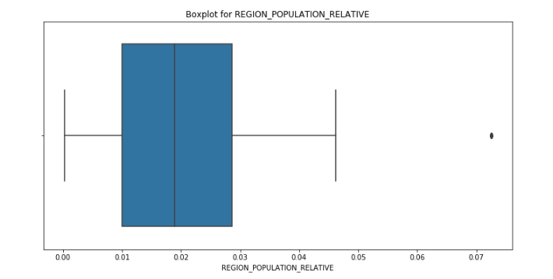
Outliers in the data:
Basically Outliers are the data points those are away from MIN or MAX values in a column.
We used BoxPlot to identify these Outliers.
The Columns those had outliers are :
REGION_POPULATION_RELATIVE
DAYS_EMPLOYED
HOUR_APPR_PROCESS_START
AMT_REQ_CREDIT_BUREAU_YEAR
From the adjacent graph for REGION_POPULATION_RELATIVE, we can see that there is data point which is far away from MAX value in the BoxPlot.
Hence this is the column containing outliers.

Slide 6
Univariate Analysis for Dataframe with TARGET = 0
To get insights in to the data, we plotted bar graphs for Categorical and Continuous column for the data frame with Target = 0.
The columns chosen for the analysis were :
Categorical Columns:
Gender
Family Status
Education
Relationship Status
Employment Status
Continuous Columns :
Amount Annuity
Amount Credit
Total Income
Amount Goods Price
Count of Family Members

Slide 7
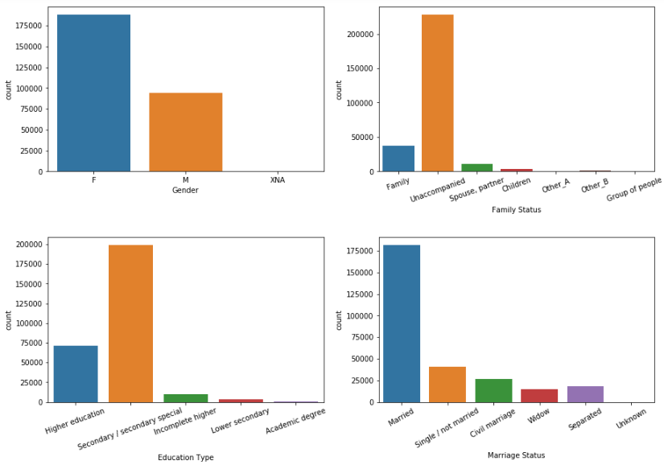
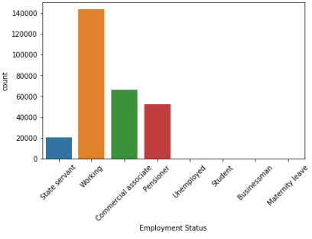

Slide 8
Univariate Analysis for Gender :
From the Bar graph plotted for Gender, we can see that the Number of Females are more than Males.
From this we can say that, Female(F) did not have as many issues as Male in returning the loan amount.
We can clearly say that, as women return the loan amount taken on time, their loan should be sanctioned as soon as possible.
Univariate Analysis for people with different Family Status :
By looking at the graph plotted for Family Status, one can clearly say that people those are unaccompanied, tends to return the loan on time.
Hence while approving the loans, status of family can be a key factor as number of family members can increase the spend which in turn impact the loan.
Univariate Analysis for people with different education background :
People those have Higher / Secondary Education are more in number those are not having issues while returning the loan amount.
From this we can say that educated people return the loan on time as they know the impact the late payment causes on CIBIL score which is not known to the people with less education.

Slide 9
Univariate Analysis for Married :
Its interesting to see that number of people who has taken and returned payment on time are the married people.
Hence it can be said that when married, due to various reasons there is a need for money, say for purchasing homes or Trips.
Hence Relationship status is also important while sanctioning the loans.
Univariate Analysis for Married :
Working Individuals, Commercial Associate and Pensioners have not defaulted.
Which implies that we can approve loan requests of people with these professionals
Overall Result:
From all the above analysis, we can state that:
Look at the Family status, Relationship status ,Education Type of the applier while giving the loan. As these factors majorly impact the person while returning the loan on time.

Slide 10
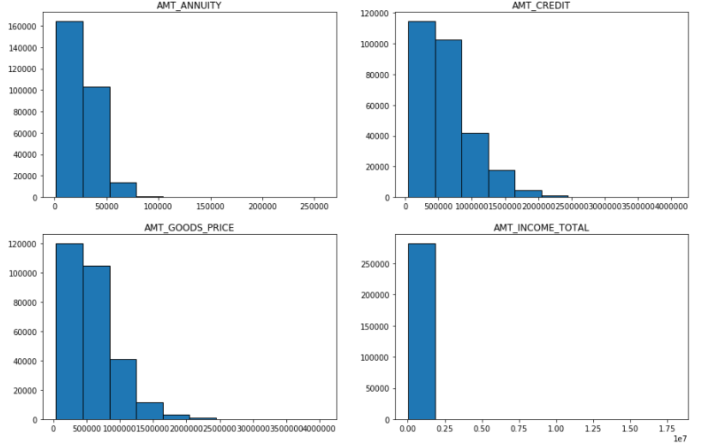
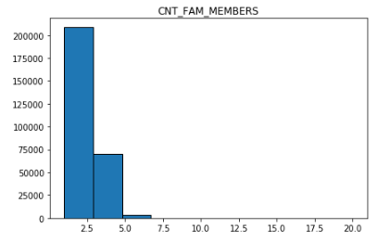

Slide 11
Univariate Analysis for Amount Annuity, Amount Credit, Amount Goods Price, Total Income and Count of Family Members :
Above columns are chosen, because they can influence others values directly.
Amount Annuity : Loan Annuity & Amount Credit : Credit Amount of the Loan
As observed in the graph, these two are directly proportional amounts. Hence if Amount annuity is more then Credit amount given is also more.
Amount Goods Price, Amount Annuity And Amount Income
All of these fields are directly proportional as seen in the graph,
If one increases other also increases.
Income of individual is more it means he can pay on time and can be given large credit loan without having any issues in returning the payment

Slide 12
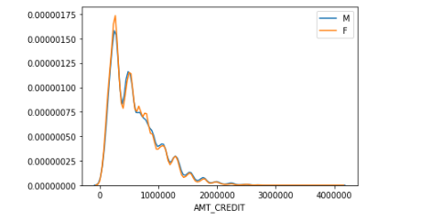
Bivariate Analysis for Dataframe with TARGET = 0:
Bivariate Analysis for Gender and Amount Credit given :
From the above graph plotted for Credit Amount offered to Male and Female, when they have no issues in returning the loan
We can observe that, both are offered the same credit loan with a little spike for Female. Hence it can be said that, while giving out the loans, Genders are not considered.
But as per our previous analysis for Gender, Females return the payment on time, so they should be prioritized.
While giving loan to Men, all other factors must be considered so as to make sure timely payment.

Slide 13
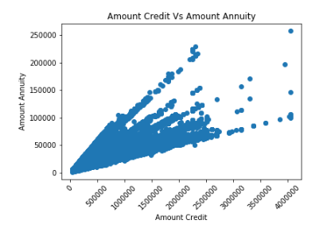
Scatter Plot for Amount Credit and Amount Annuity
As stated earlier, Amount Annuity and Amount Credit are closely related.
This can be seen from the plot, as Annuity is increasing Credit given is also increasing.
After 30,00,000, its not densely populated as its below, From this it can be said that people who have been paying on time are having amount credit upto Rs 30,00,000.
Above that limit, credit is given to a little number of people.

Slide 14
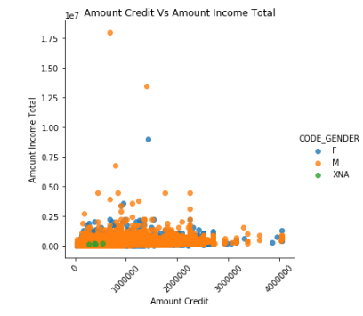
Analysis for Gender, Amount Credit and Total Income of Individual
Amount Credit is the amount offered to a individual after he/she passes all the criterion for Approval.
From the plot we can see that, individuals having income upto 50k have applier for the loan and are paying it back in time.
So we can increase the credit offered to them as they have not defaulted. This includes both Male and Female.

Slide 15
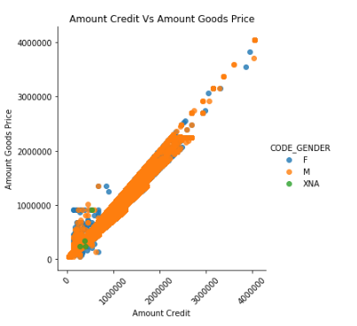
Amount Goods Price and Amount Credit :
Amount Goods price is the price given for the objects that customer is providing ( Like Gold, land, House, etc).
If the price of Goods is high, then credit given to him is also high and it can be seen from the plot.
In conclusion, these are directly proportional fields.

Slide 16
Highly Correlated columns (Bivariate Analysis) :
As concluded earlier, Amount Goods Price and Credit Amount are highly correlated with a 0.98 value
Then Amount Goods Price and Amount Annuity with 0.77 value.
Then Amount Income Total and Credit Amount with 0.34 Value.
(All these are selected by observing relation between columns)
All the highly correlated variables can be seen in above table.

Slide 17
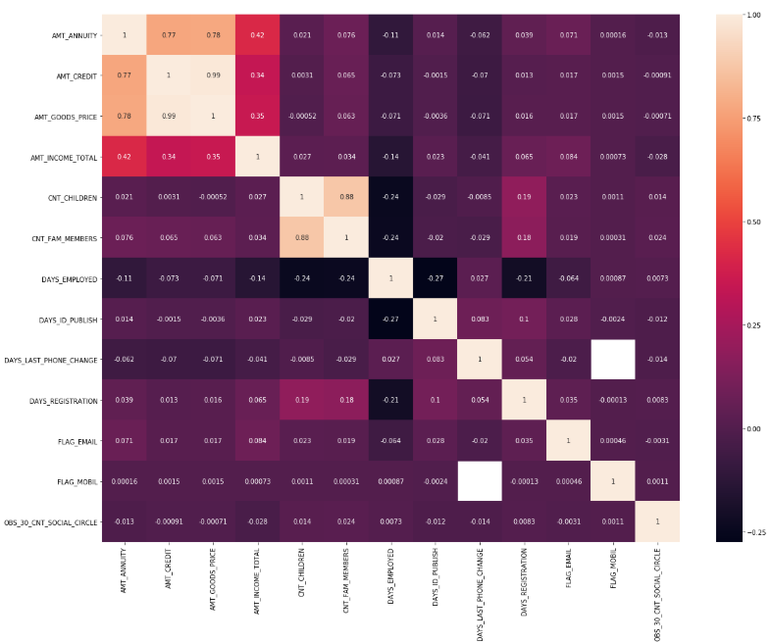

Slide 18
Univariate Analysis for Dataframe with TARGET = 1
The columns chosen for the analysis were :
Categorical Columns:
Gender
Family Status
Education
Relationship Status
Employment Status
Continuous Columns :
Amount Annuity
Amount Credit
Total Income
Amount Goods Price
Count of Family Members

Slide 19
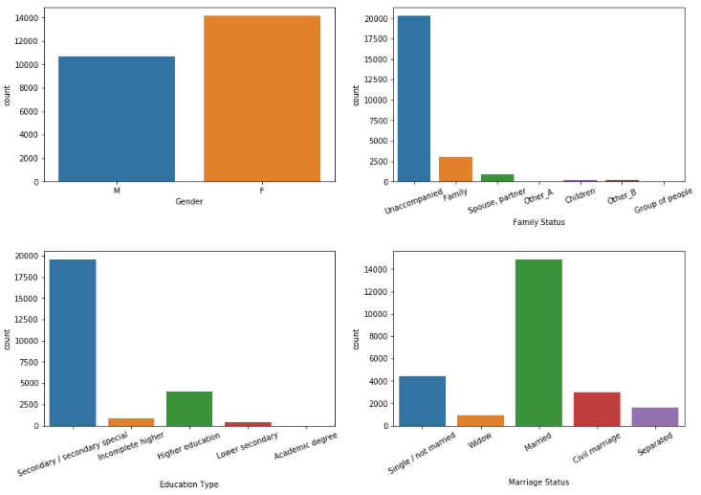
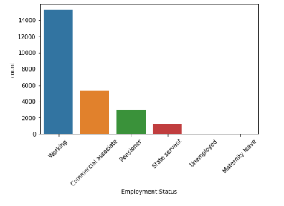

Slide 20
Univariate Analysis for Gender :
From the Bar graph plotted for Gender, we can see that the Number of Females are more than Males.
From this we can say that, Female(F) had issued in returning the loan amount.
But as per our earlier analysis for Target = 0, Females returned the loan on Time also.
Hence we need to verify the conditions that individual is in and the other factors such as Family Status, Relationship status, Income and Education.
For Men, they are in lower number and had issues in returning the loan but not as much compared to women.
Univariate Analysis for people with different Family Status :
By looking at the graph plotted for Family Status, one can clearly say that people those are unaccompanied, had issues in returning the loan.
This is in contrast to the findings from Target = 0 because there also Unaccompanied Individuals returned loan on Time.
So we can say that, deeper analysis is required to get more insights.

Slide 21
Univariate Analysis for Married :
Married people are more in number here those defaulted, reason can be income status or other personal issues.
But the number of appliers those are married is more in both the cases.
Which indicates Married People must be given priority as they will need more and more loan as time passes.

Slide 22
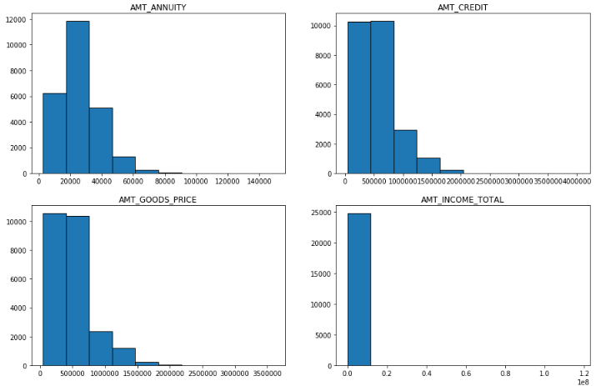
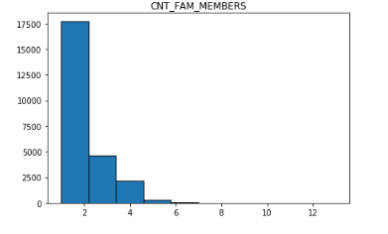

Slide 23
Univariate Analysis for Amount Annuity, Amount Credit, Amount Goods Price, Total Income and Count of Family Members :
Above columns are chosen, because they can influence others values directly.
Amount Annuity : Loan Annuity & Amount Credit : Credit Amount of the Loan
As observed in the graph, these two are directly proportional amounts. Hence if Amount annuity is more then Credit amount given is also more.
Amount Goods Price, Amount Annuity And Amount Income
All of these fields are directly proportional as seen in the graph,
If one increases other also increases.
Income of individual is more it means he can pay on time and can be given large credit loan without having any issues in returning the payment
In Comparison with Target = 0
All the columns are correlated to each other for Target = 1. Same was observed in Target = 0.

Slide 24
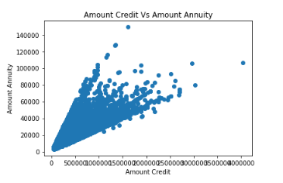
Bivariate Analysis for Target = 1

Slide 25
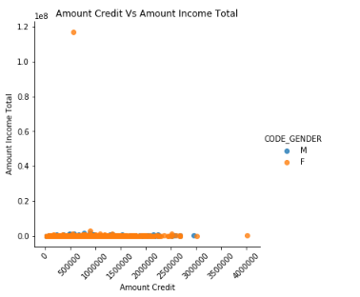

Slide 26
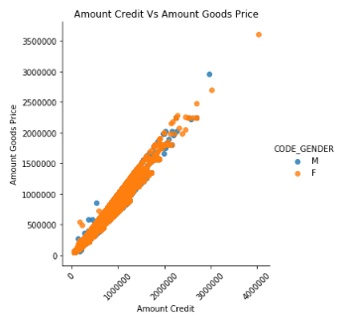

Slide 27
Highly Correlated columns (Bivariate Analysis) :
Correlation / Bivariate Analysis for Target = 1
For Target =1 also, Amount Goods Price and Credit Amount are highly correlated with a 0.98 value
Then Amount Goods Price and Amount Annuity with 0.77 value.
Then Amount Income Total and Credit Amount with 0.34 Value.
(All these are selected by observing relation between columns)
All the highly correlated variables can be seen in above table.
Correlation for Target = 0 & Target = 1
All the highly related columns those were observed in Target = 0 are found in correlation for Target = 1.
Hence we can say that, there was no distinguishing factor while sanctioning the loans.
People defaulted after sanctioning the loans.

Slide 28
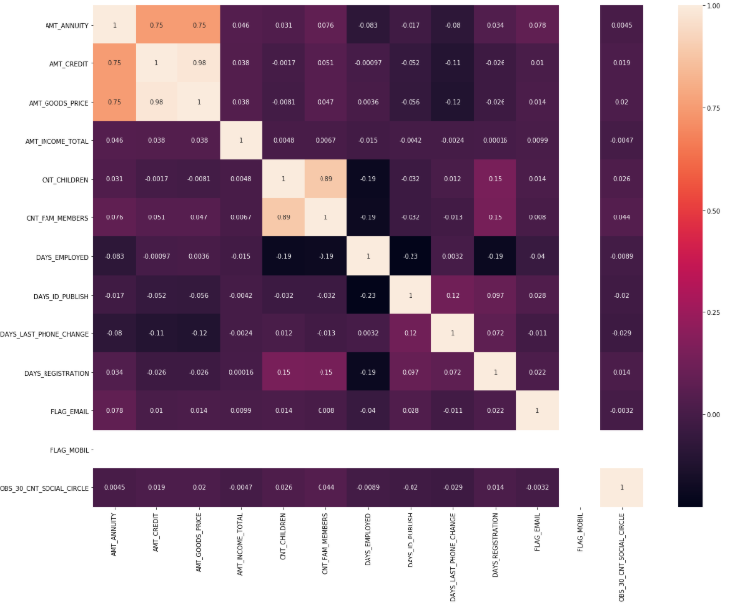

Slide 29
Merge Data Together
Application Data and Previous Applications data is merged together on “SK_CURR_ID”

Slide 30
Univariate Analysis for merged data frame with Target = 0
Univariate Analysis for
Categorical Columns
Gender
Contract type
Contract Status
Payment Type
Client Type
Goods Category
Continuous Columns
Amount Annuity
Amount Annuity for Perv Applications
Amount Credit
Amount Credit for Prev Applications
Amount Goods Price
Amount goods price for Prev Applications

Slide 31
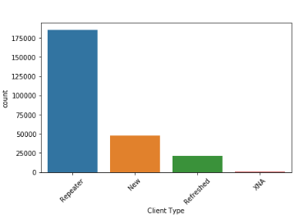
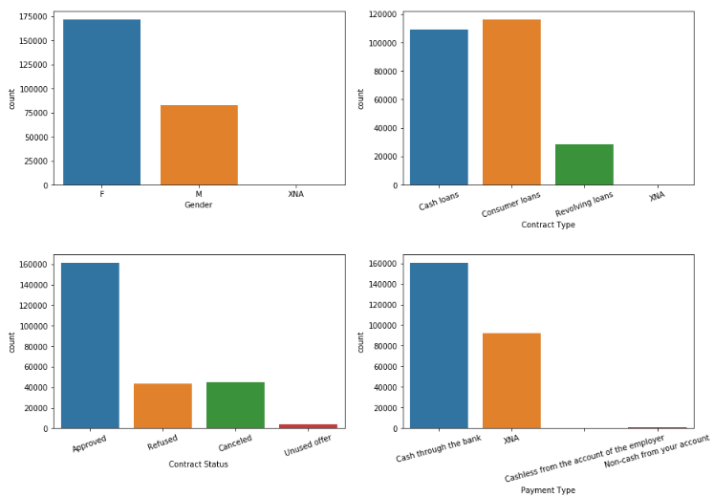
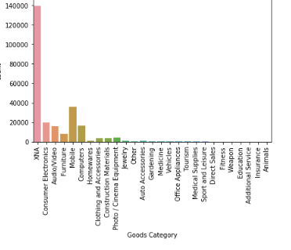

Slide 32
Univariate Analysis for Gender:
When the graph is observed, it seems that number of Female's those have applied for the loan are more than the number of Male's.
Reason behind this can be Female's have not defaulted as much as Men's have.
Taking this trend in to consideration, Female’s can be given more offers in Loan and their loan applications can be approved ASAP.
Univariate Analysis for Payment Type
Number of individuals those have taken cash directly is way more than any other transactions.
Univariate Analysis for Contract Status
Number of loan applications those are approved are more than Rejected or Cancelled applications.
From this we can say that, applications needs to be checked thoroughly before approving.

Slide 33
Univariate Analysis for Client Type
Repeater Consumers are more in number than New or Refreshed. This indicates that people have applied for new loans which means they have not defaulted during the previous loan payment process.
This can be a key factor in deciding the approval process.

Slide 34
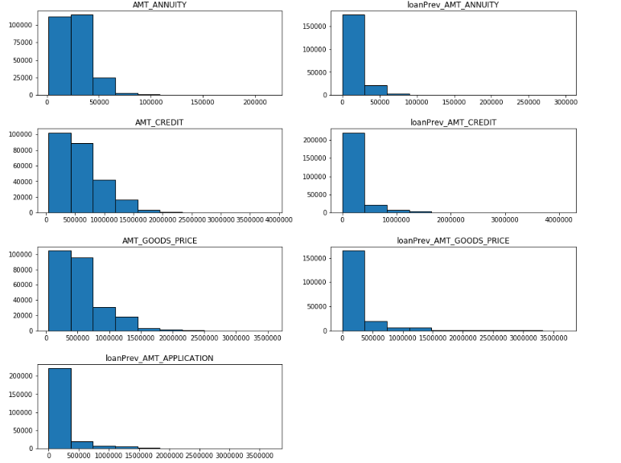

Slide 35
Amount Annuity VS Amount Annuity for Previous Application
When these two columns are plotted , it indicates that there is not much change in the Amount Annuity provided for the consumers.
Amount Credit VS Amount Credit for previous Application
Same observation applies for these columns.

Slide 36
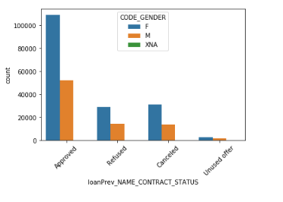
Bivariate Analysis
Bivariate analysis between Gender and Status of Applications :
As we stated earlier, number of Female's those have applied for loan applications are more than Male's
Same observation is valid here.
From the above bar graph we can say that, approved applications are more for Female's more than Male's
Female applications are more in number in all the status.

Slide 37
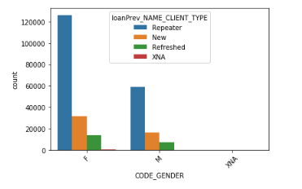
Plotting Gender Vs Client Type
After plotting two categorical variables, we can see that repeat consumers are in more numbers for Male and Female.
It signifies that consumers reapply for loans once its declined or they need a new loan.
We can choose to approve these repeaters as they have completed payment for their previous loan amounts.
After Repeaters, New Loan consumers can be prioritizes as they will not default as they will think about maintaining CIBIL score.

Slide 38
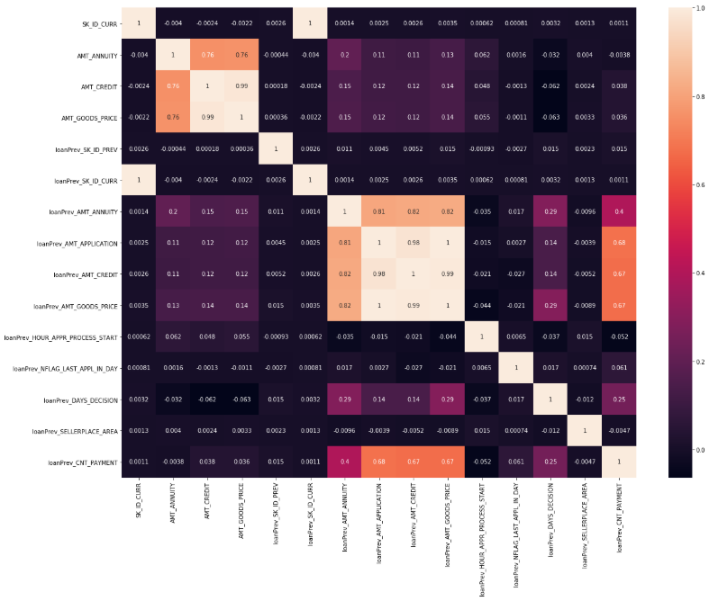

Slide 39
Correlation ( Bivariate Analysis)
From the Heatmap and table, we can see that Goods Price and Amount Applications are highly correlated with 0.9998 value
followed by Goods price correlated with Amount credit for previous applications.
Same trend can be seen for current applications as Goods Price is correlated with Amount credit with a value of 0.9864.

